Slide 1
Online Programs & Parental Involvement
Bridgeprep Academy of Greater Miami
August 27, 2019
Ms. Ortiz, Principal
Mrs. March, Assistant Principal

Slide 2
Online Programs

Slide 3
ISTATION
Reading, Math and Spanish Intervention program.
https://info.istation.com/reading_ebrochure
Must download the Istation Application to your computer.
Istation Support

Slide 4
ACHIEVE 3000
What is Achieve 3000?
Achieve3000 is the leader in online differentiated instruction, serving millions of students worldwide. For over 15 years, the company has been reaching students at their precise Lexile® reading levels to deliver significant reading gains.
https://vimeo.com/172412234
How to Log in?
https://login.achieve3000.com/index

Slide 5
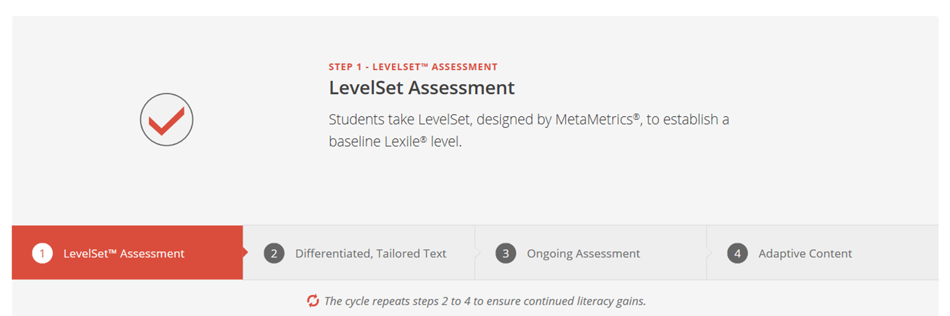

Slide 6
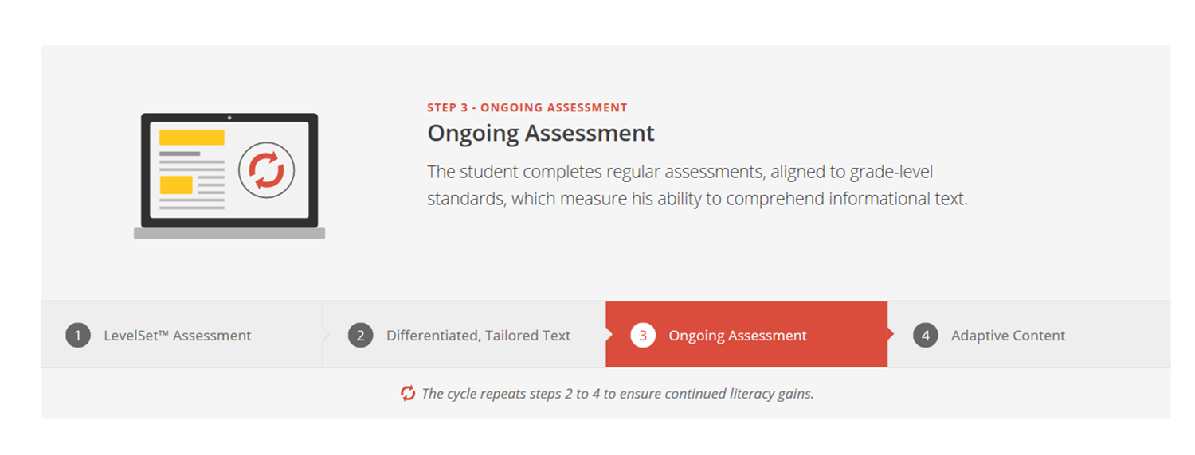
Achieve 3000

Slide 8
Parental Involvement
Class Dojo
https://www.classdojo.com/about/
Student Grades
http://www.dadeschools.net/parents.asp
Bridgeprep Academy Website
https://bridgeprepgreatermiami.com/
Parents’ Guide to Student Success by PTA
https://www.pta.org/home/family-resources/Parents-Guides-to-Student-Success

Slide 9
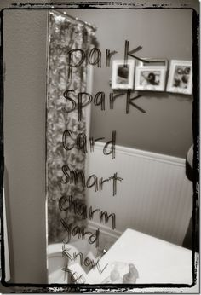
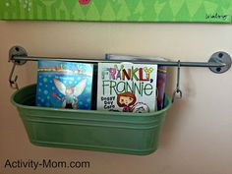
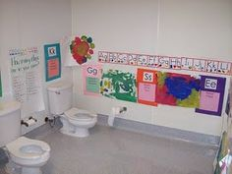
Reading Everywhere!

Slide 11
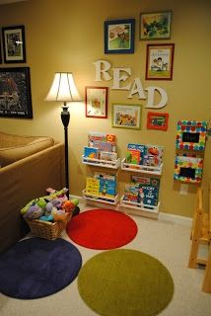
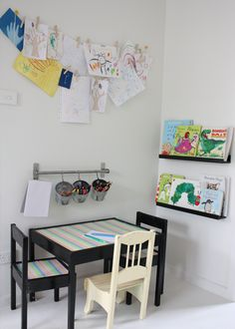
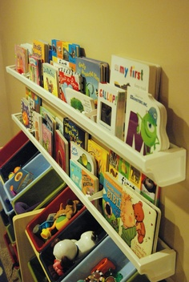
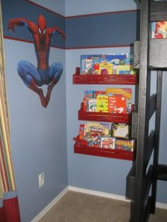

Slide 12
Remember These 10 Guiding Principles
Family members are equal partners in a child’s education.
The home environment is the “primary” educational environment.
Schools must respect the diversity of families and their varied needs.
All families care about their children.

Slide 13
Family involvement is important through all years of a child’s education.
Family involvement takes many forms and may not require a family’s presence at school.
Families, schools, and communities are closely interconnected and must collaborate in educating children.

Slide 14
BPA Book Swap! (Every Friday starting September 13th) 1. Bring in a gently used book that you have already read. 2. Drop it off at our Book Swap Cart. 3. Choose a “new” book to take home and read.

Slide 15
Thank you for trusting us with your child. We are looking forward to a successful school year.

